Slide 1
LAB # 1
DATA STRUCTURE AND ALGORITHM
ENGR SIDRA MUDASSAR

Slide 2
SELF INTRODUCTION
SIDRA MUDASSAR (LAB ENGINEER)
EMAIL:
sidramudassar90@gmail.com
sidramudassar.bukc@bahria.edu.pk
SITE LINK:
https://sites.google.com/view/bce786

Slide 3
INTRODUCTION TO C ++

Slide 4
INTRODUCTION
C is a programming language developed in the 1970's alongside the UNIX operating system.
C provides a comprehensive set of features for handling a wide variety of applications, such as systems development and scientific computation.
C++ is an “extension” of the C language, in that most C programs are also C++ programs.
C++, as opposed to C, supports “object-oriented programming.”

Slide 5
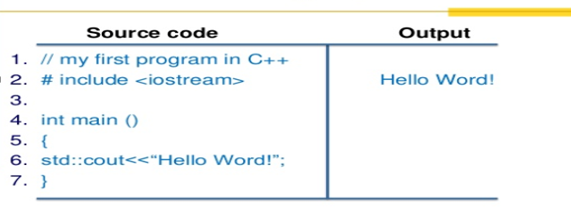
Structure of a c ++ program

Slide 6
Input statements
cin >> variable-name;
Meaning: read the value of the variable called <variable-name> from the user
Example:
cin >> a;
cin >> b >> c;
cin >> x;
cin >> my-character;

Slide 7
Output statements
cout << variable-name;
Meaning: print the value of variable <variable-name> to the user
cout << “any message “;
Meaning: print the message within quotes to the user
cout << endl;
Meaning: print a new line
Example:
cout << a;
cout << b << c;
cout << “my name is : “ << a << endl;

Slide 8
Comment in c ++
Comments appear in green in Visual C++.
There are two ways to include comments in a program:
Example:
// A double slash marks the start of a //single line comment.
/* A slash followed by an asterisk marks the start of a multiple line comment. It ends with an asterisk followed by a slash. */

Slide 9
Introduction to Data Structures
Data Structure is a systematic way to store and organize data to use it efficiently. Following terms are foundation terms of a data structure.

Slide 10
Introduction to Algorithms
Algorithm is a step by step procedure, which defines a set of instructions to be executed in certain order to get the desired output. Algorithms are generally created independent of underlying languages, i.e. an algorithm can be implemented in more than one programming language.

Slide 11
Characteristics of an Algorithm
From data structure point of view, following are some important categories of algorithms
Search
Algorithm to search an item in a data structure.
Sort
Algorithm to sort items in certain order.
Insert
Algorithm to insert item in a data structure.
Update
Algorithm to update an existing item in a data structure.
Delete
Algorithm to delete an existing item from a data structure.

Slide 12
Characteristics of an Algorithm
An algorithm should have the below mentioned characteristics
Unambiguous
Algorithm should be clear and unambiguous. Each of its steps (or phases), and their input/outputs should be clear and must lead to only one meaning.
Input
An algorithm should have 0 or more well-defined inputs.
Output
An algorithm should have 1 or more well-defined outputs, and should match the desired output.
Finiteness
Algorithms must terminate after a finite number of steps.

Slide 13
How to write an algorithm?
There are no well-defined standards for writing algorithms. Rather, it is problem and resource dependent
.
Problem − Design an algorithm to add two numbers and display result.

Slide 14
solution
step 1 − START
step 2 − declare three integers a, b & c
step 3 − define values of a & b
step 4 − add values of a & b
step 5 − store output of step 4 to c
step 6 − print c
step 7 − STOP

Slide 15
2nd Solution
step 1 − START ADD
step 2 − get values of a & b
step 3 − c ← a + b
step 4 − display c
step 5 − STOP

Slide 16
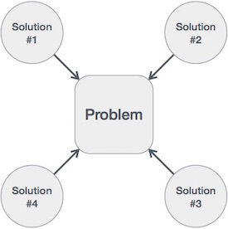
We design an algorithm to get solution of a given problem. A problem can be solved in more than one ways.

Slide 17
LAB TASK
Write a C++ Program that read a float input from user and store it in variable amount. add 16 to an integer num if the value of amount in greater than 5.4. Print out the results of both variables on screen.
Write a C++ Menu driven program that allows a user to enter five numbers and then choose between findings the smallest, largest, sum or average. Use else if statement to determine what action to take.

Slide 18
LAB TASK
Write a C++ program that takes a positive integer from user and store it in variable posNumber. Follow these conditions;
If the number is less than 1, print wrong input.
If it is 1, Print its value.
If value is greate than 1, check the value is it Even or Odd.
If it is Even, half it and print.
If it is Odd, multiply it by 3 and print result.
Repeat the whole process until user enter 1.

Slide 19
Lab Tasks
Create a program which implement an interface for simple calculator & use multiple data types to store answers and result and memory log.
Develop an Algorithm for it.
Create an interface for simple calculator.
Implement interface in SimpleCalculator class.

